Slide 1




Mobile Application Development
Produced
by
Dave Drohan (david.drohan@setu.ie)
Department of Computing & Mathematics
South East Technological University Waterford, Ireland
Updated & Delivered
by
Gongzhe Qiao (003969@nuist.edu.cn)
Department of Computer Science
Nanjing University of Information Science and Technology Nanjing, China
nuist.edu.cn
setu.ie

Slide 2

Introducing Kotlin
Overview - Part 3

Slide 3
Agenda
What is Kotlin?
Context - Java Vs JVM
Kotlin History
Milestones
General Overview & Features
Kotlin & IntelliJ IDEA
Conclusion

Slide 4
Agenda
What is Kotlin?
Context - Java Vs JVM
Kotlin History
Milestones
General Overview & Features
Kotlin & IntelliJ IDEA
Conclusion

Slide 5


Slide 6
IntelliJ Community Edition Version X.Y.Z
Refer to the Practical Labs for the current / latest version of the IDE
we will be using

Slide 7
IntelliJ Community Edition Version X.Y.Z
Can be Downloaded From (https://www.jetbrains.com/idea/download)

Slide 8
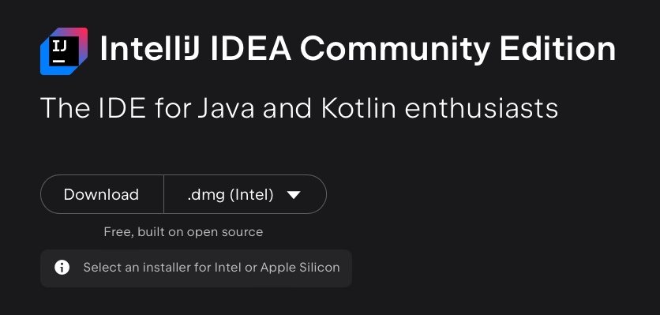
IntelliJ Community Edition Version X.Y.Z

Slide 9
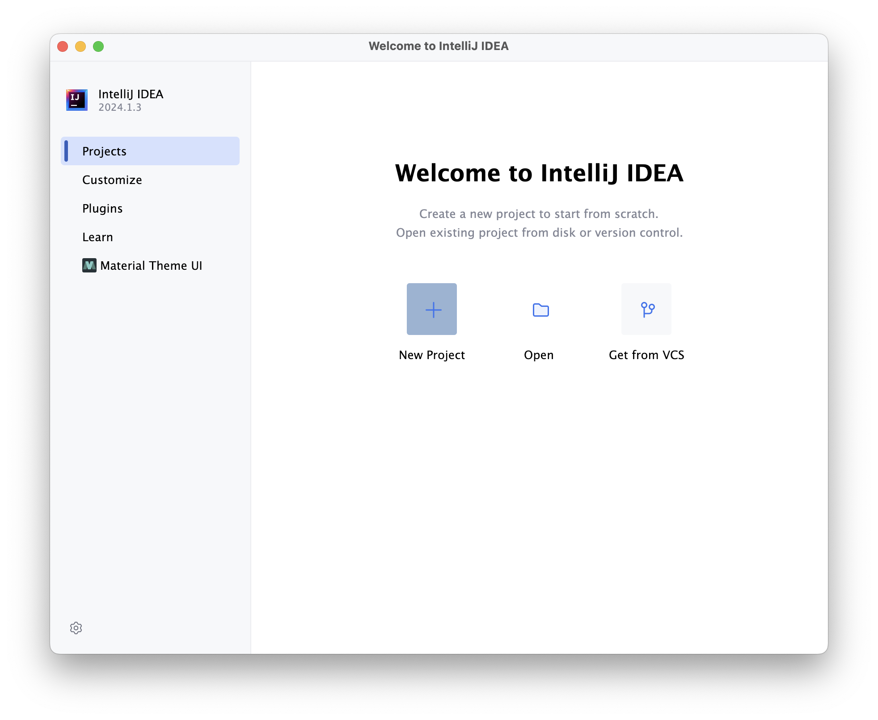
New Project

Slide 10
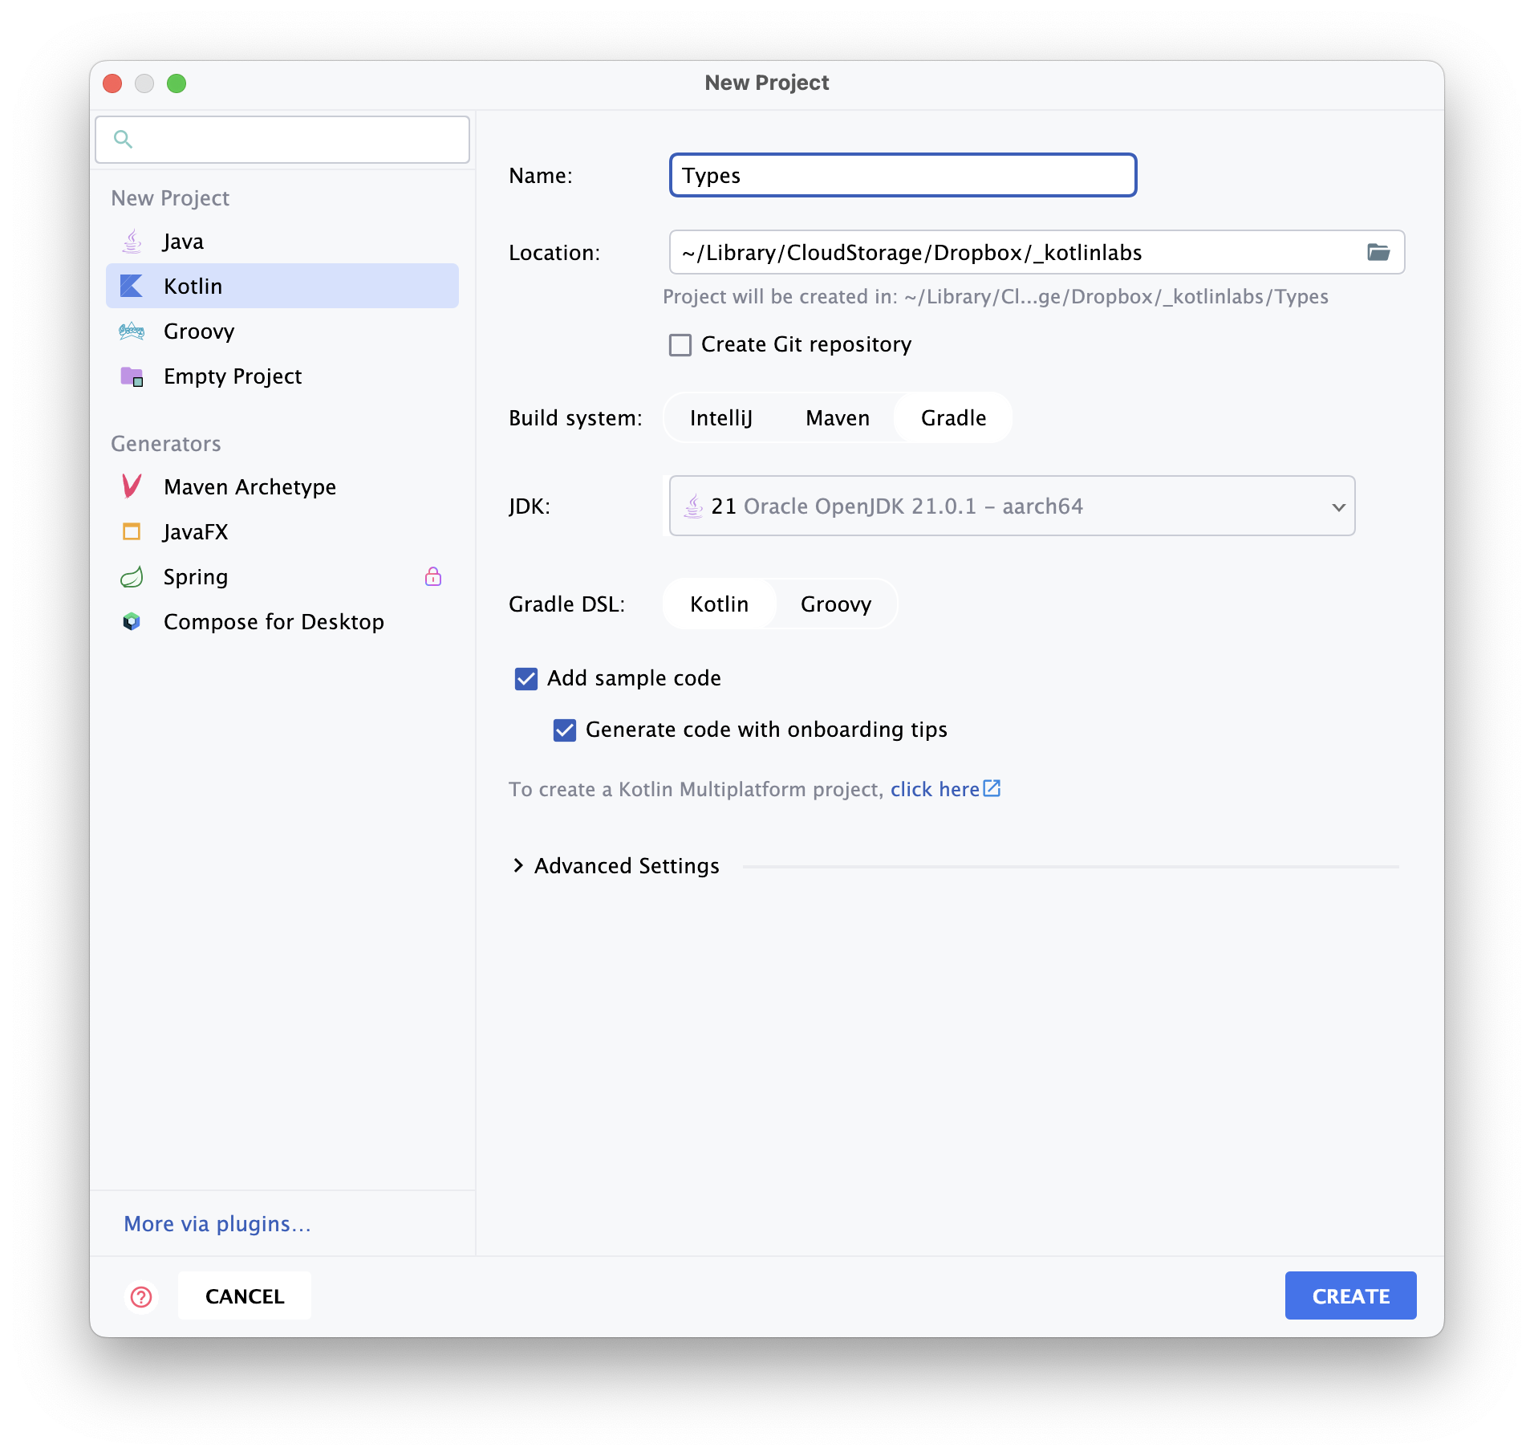
New Project

Slide 11
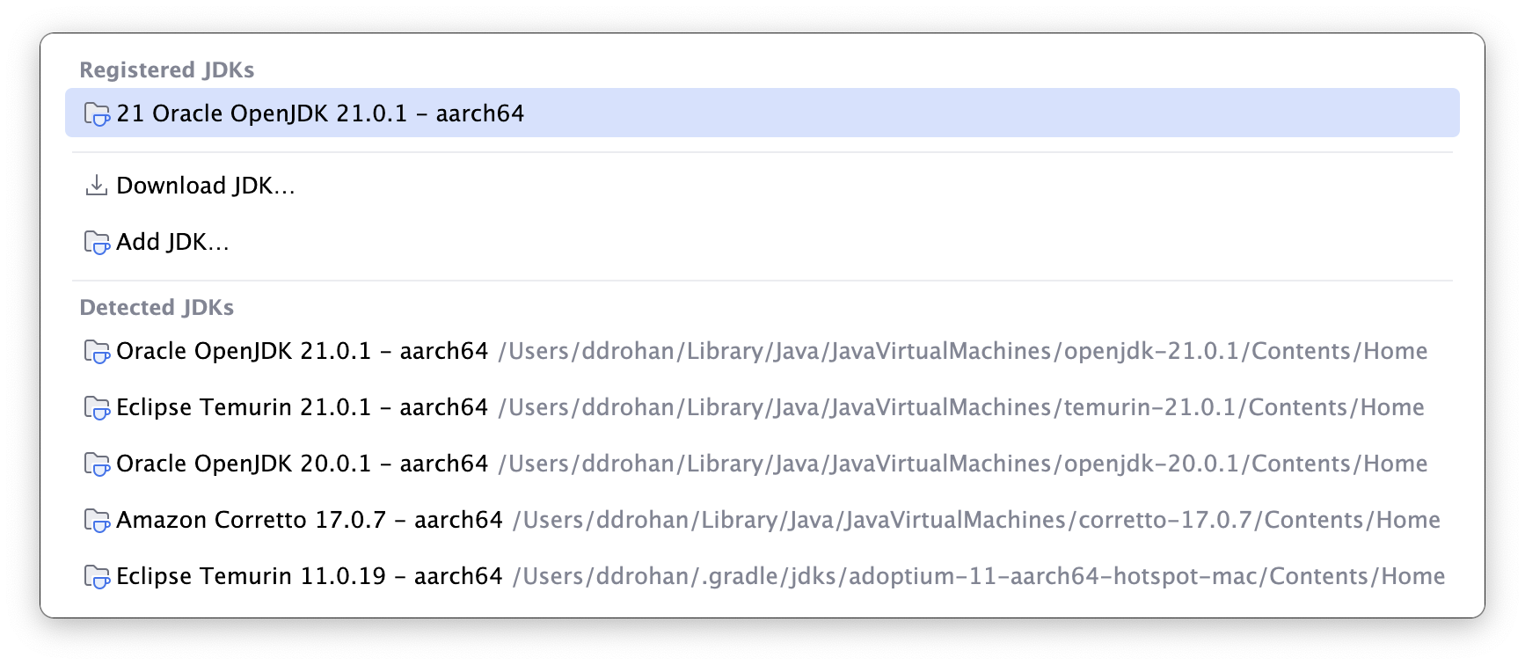
New Project

Slide 12
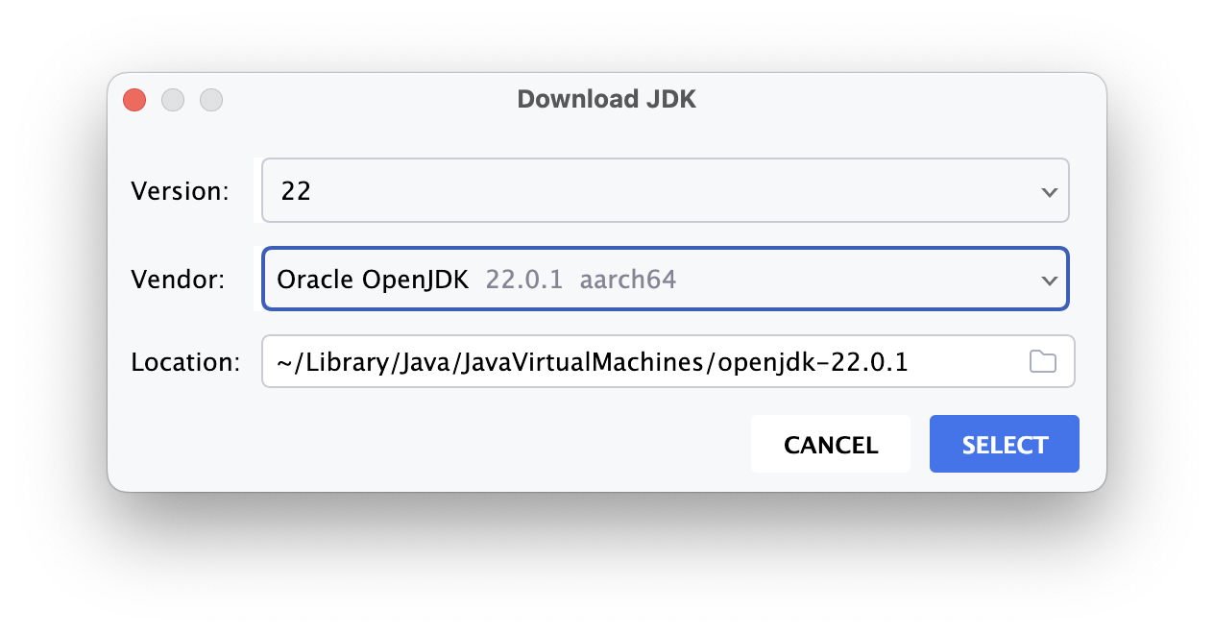
New Project

Slide 13
New Project

Slide 14
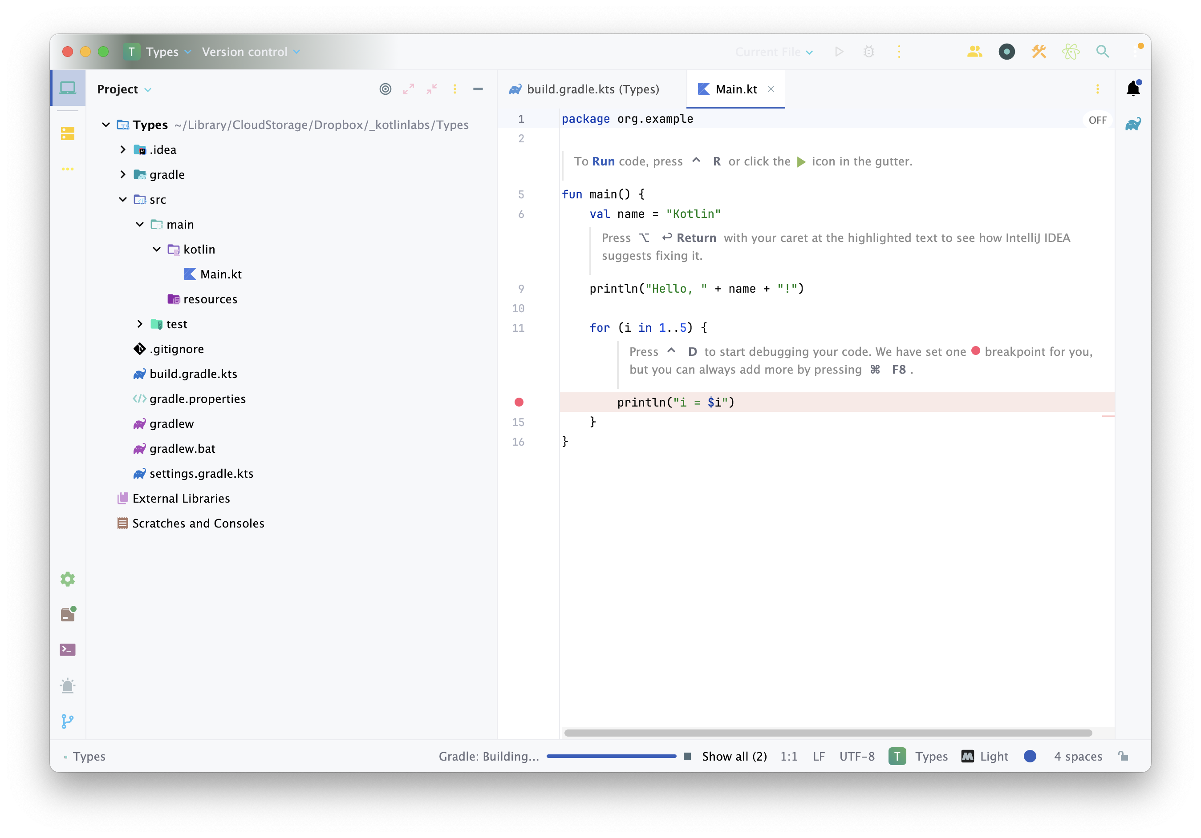
New Project

Slide 15
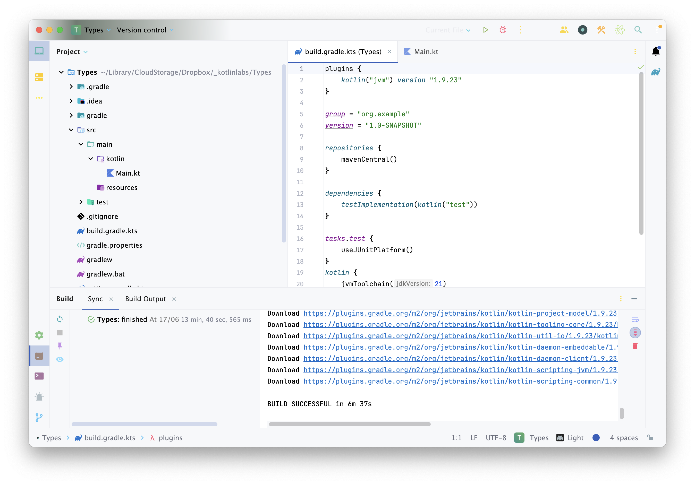
New Project

Slide 16
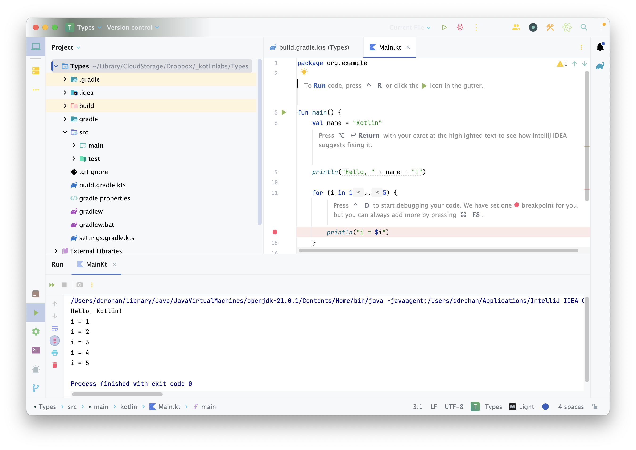
New Project

Slide 17
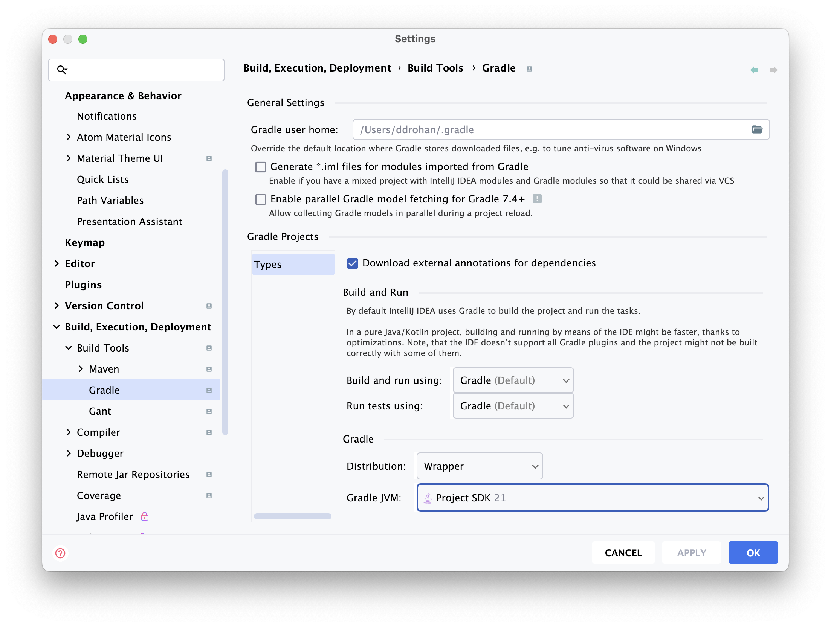
New Project

Slide 18
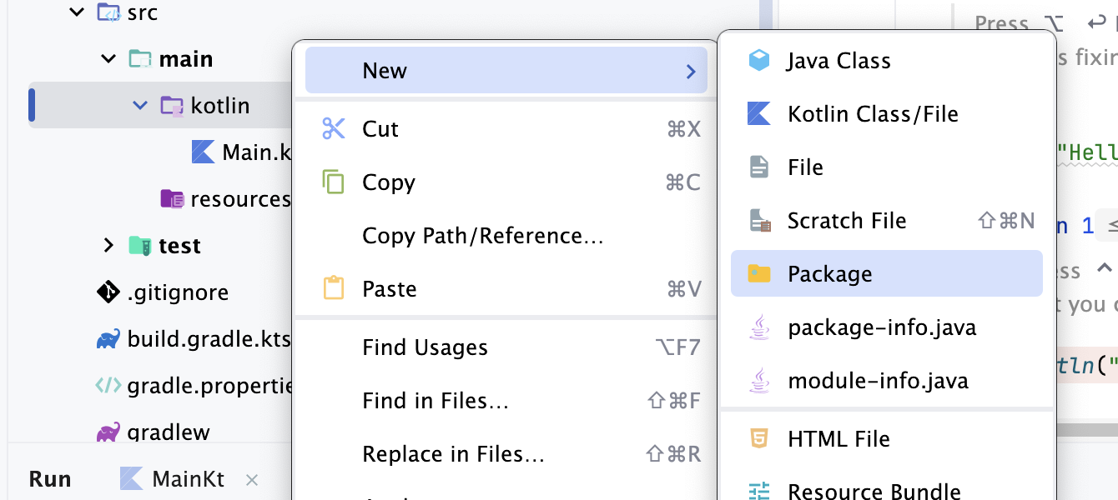
New Project

Slide 19
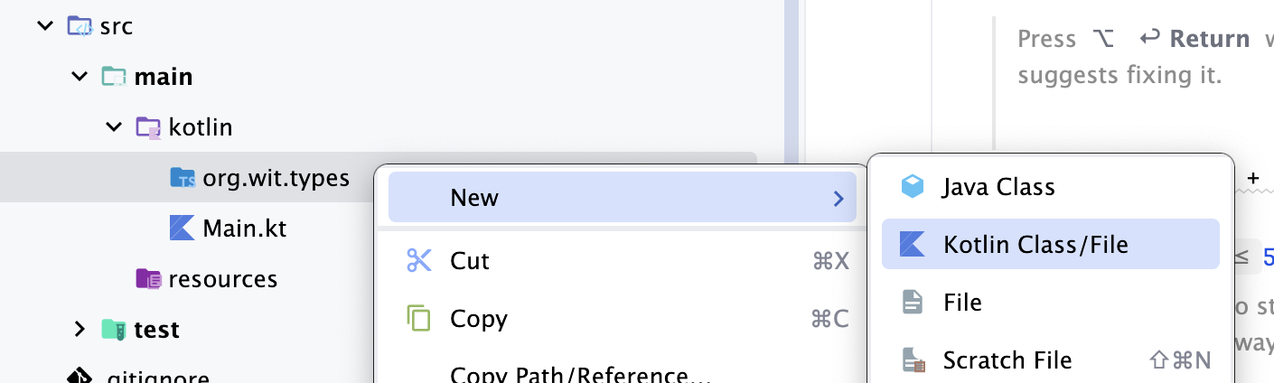
New Project

Slide 20
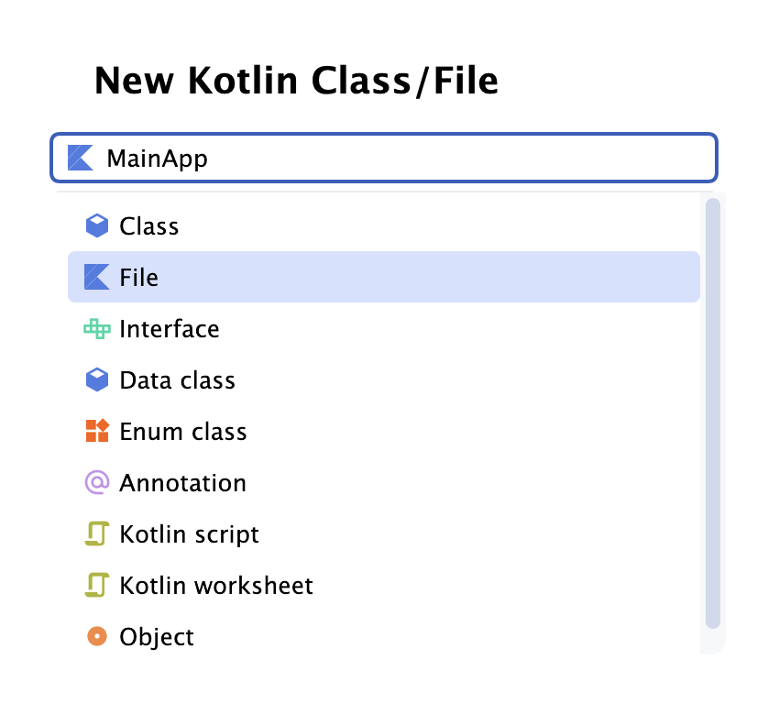
New Project

Slide 21
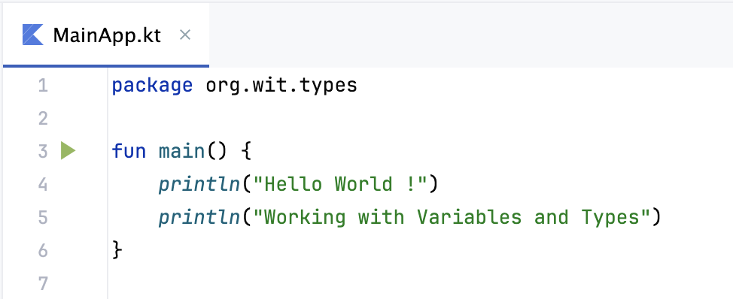
New Project

Slide 22
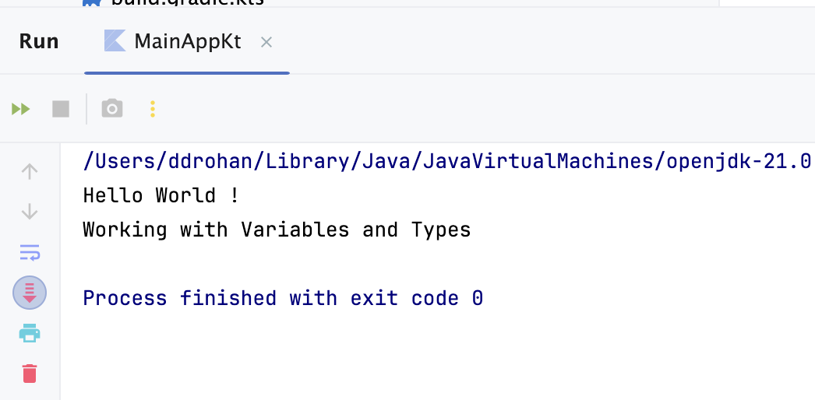
New Project

Slide 23
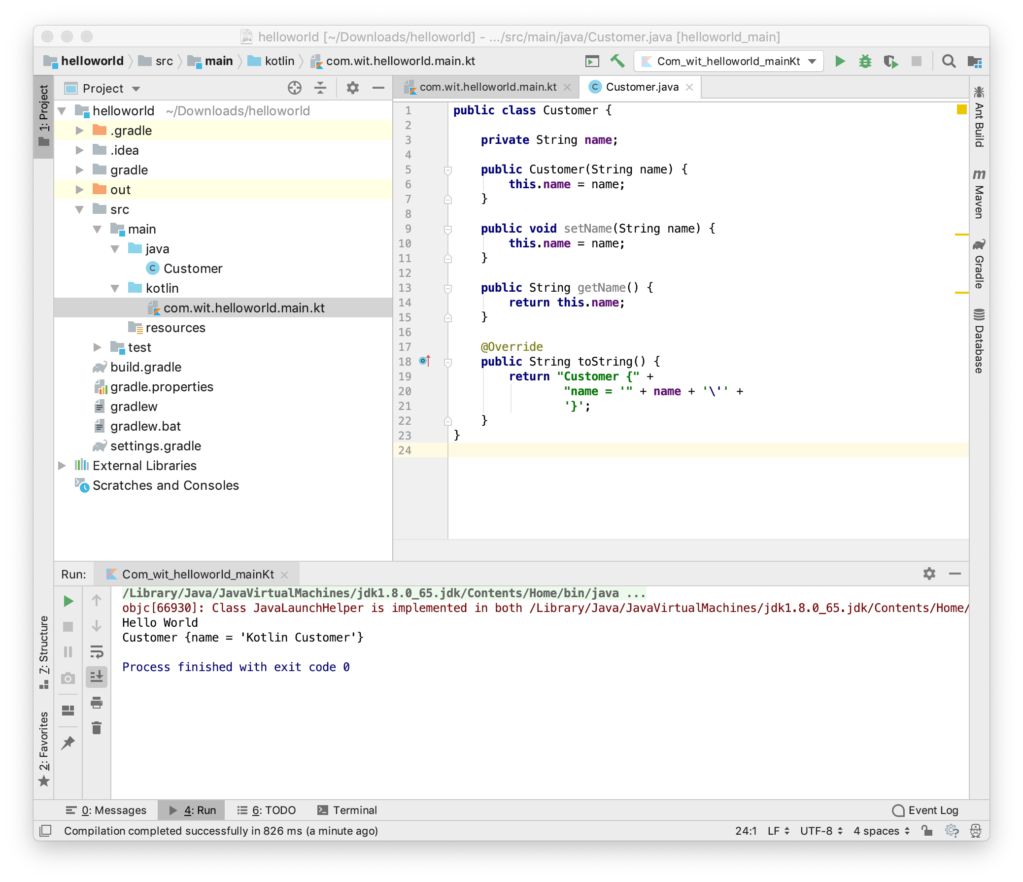
Interoperability

Slide 24
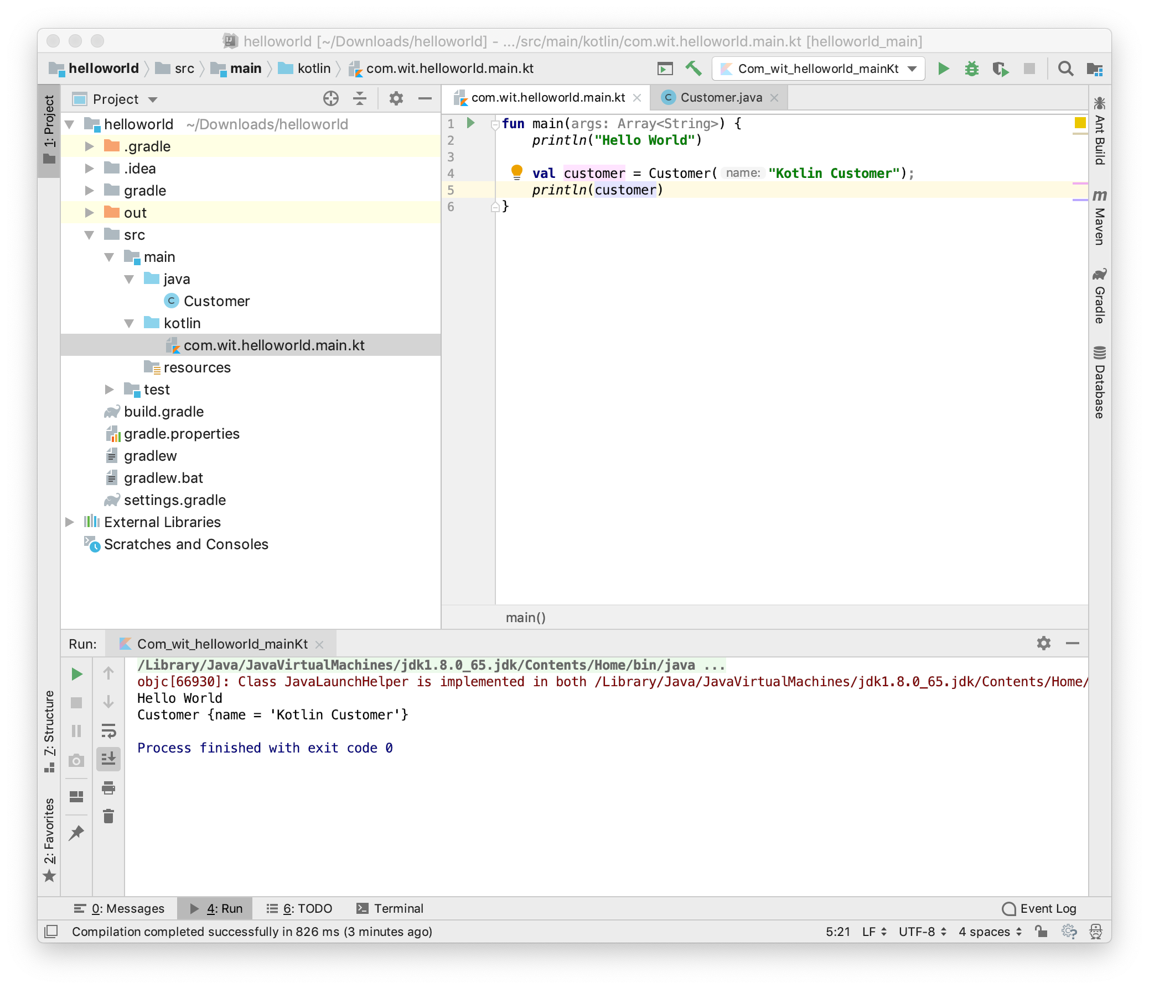
Interoperability

Slide 25
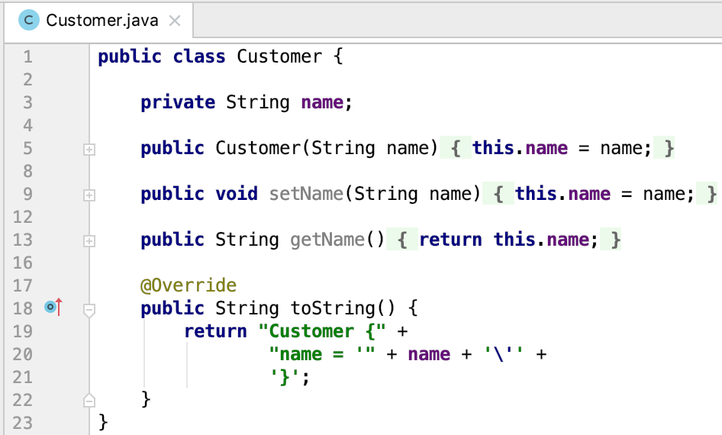
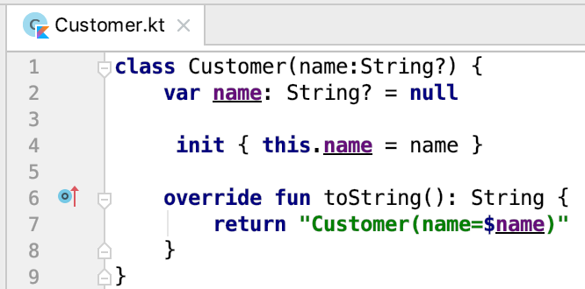
Interoperability – Java Vs Kotlin

Slide 26
Conclusion
Kotlin is low-cost: can be developed in the same IDE, in the same project as Java code
It is becoming one of the leading JVM languages
It is best suited to work with the IntelliJ IDE
And it’s currently the 1st choice language for Android Development – so that’s why we’re using it ☺

Slide 27
Agenda Recap
What is Kotlin?
Context - Java Vs JVM
Kotlin History
Milestones
General Overview & Features
Kotlin & IntelliJ IDEA
Conclusion

Slide 28



